Slide 1

AI4SD Hackathon
Defect detection in Graphene Sheets
Group 5
This network is EPSRC Funded under Grant No: EP/S000356/1

Slide 2
Index
Introduction
Workflow
Results
Conclusions & Future Work
AI4SD Hackathon

Slide 3
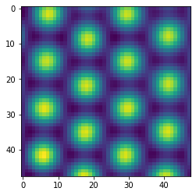
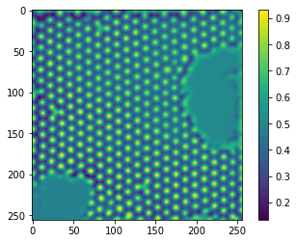
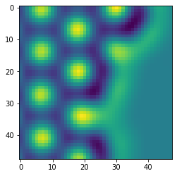
Introduction
Perfect patches
2279 patches
48x48
Classification:
Defect
No defect
Defect patches
32 patches
48x48
180 micrographs
256x256
AI4SD Hackathon

Slide 4

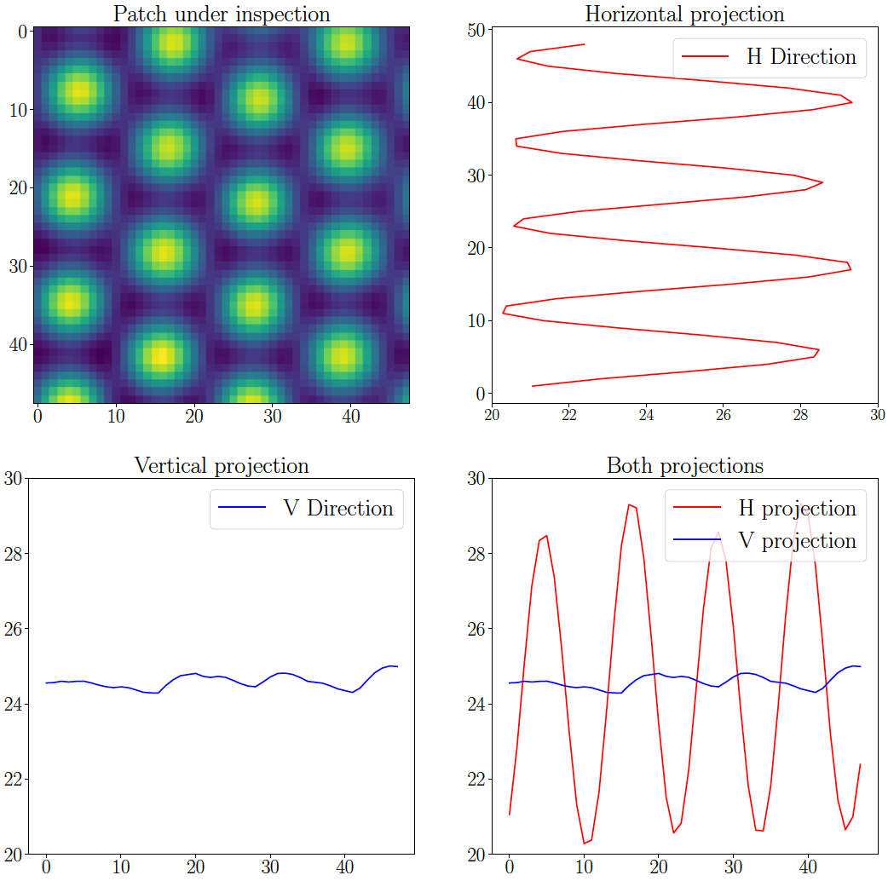
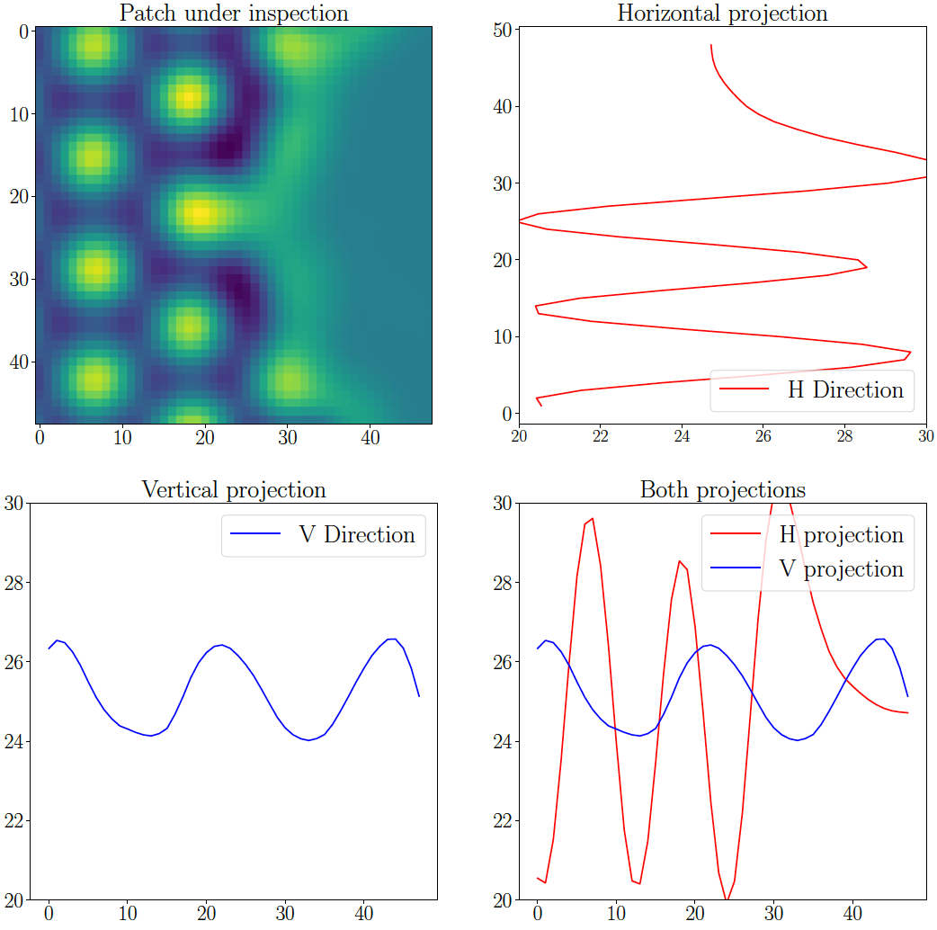
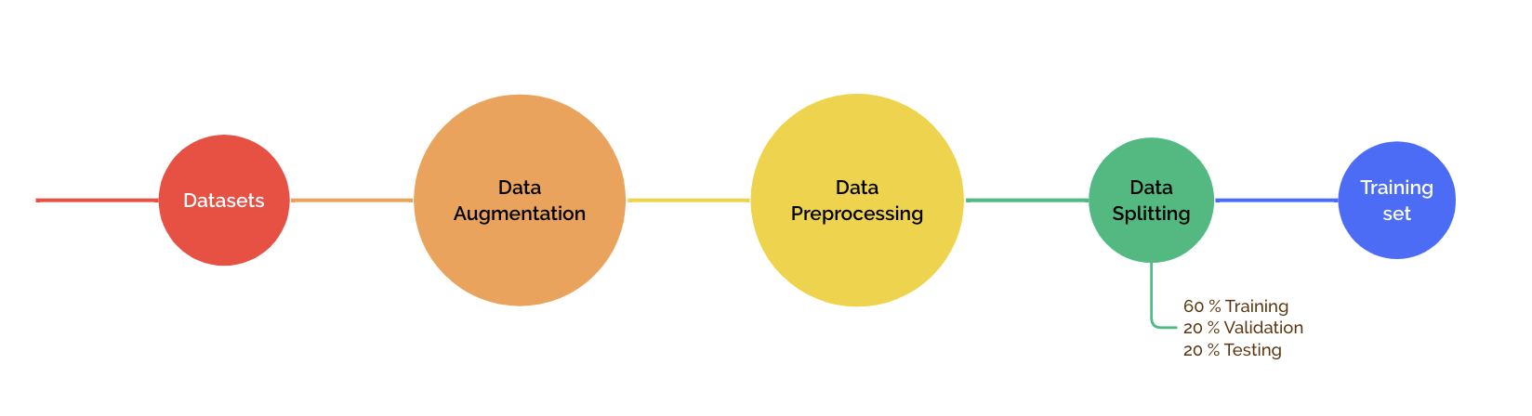
Workflow
Perfect: 2000
Defect: 2000
Perfect: 2279
Defect: 32
AI4SD Hackathon

Slide 5
Workflow
AI4SD Hackathon

Slide 6
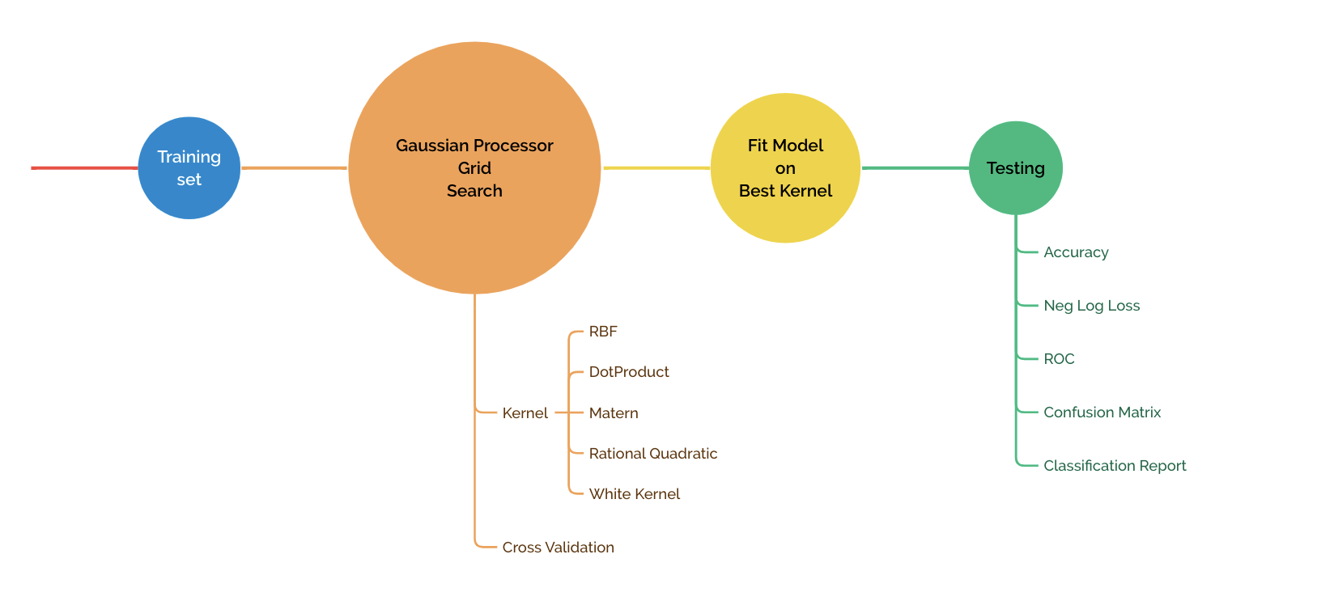
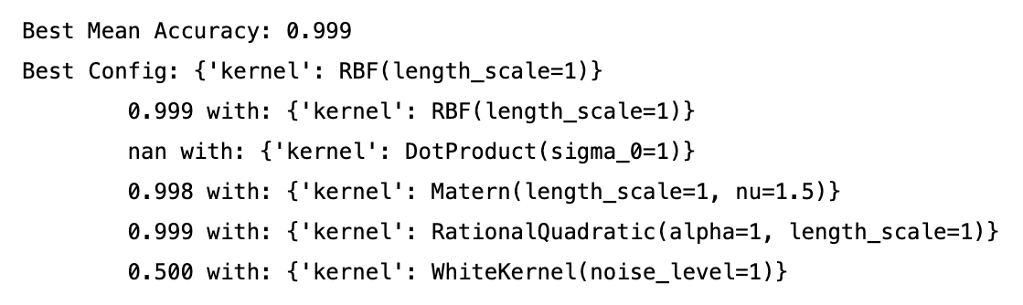
Workflow
Validation Set
Training Set
AI4SD Hackathon

Slide 7



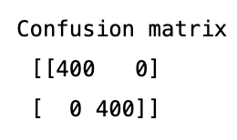
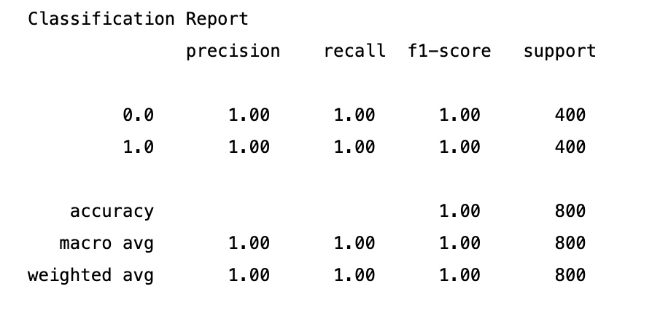
Workflow - Results
AI4SD Hackathon

Slide 8
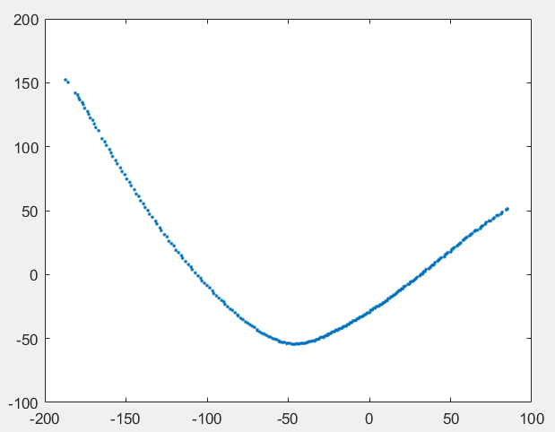
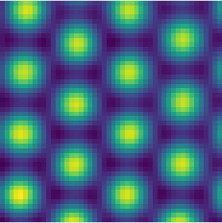
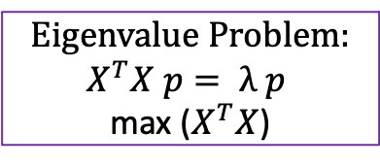
Other attempt: PCA model for image analysis
Display Graphene images
Identify principal component
Edge detection
RGB density
To visualise: 2 PC’s
Eigenvalue Problem:
$$X^{T}X p= λ p$$
max ($X^{T}X$)
AI4SD Hackathon

Slide 9
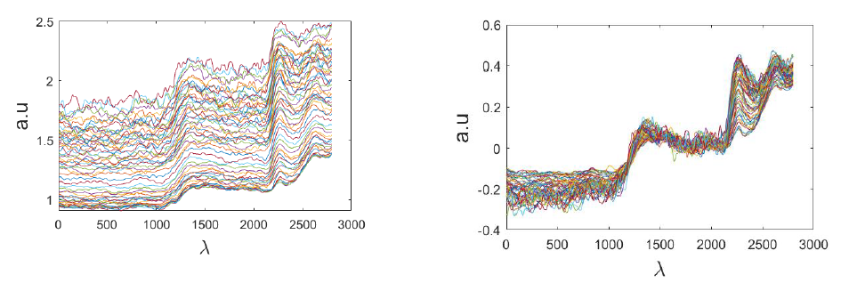
PCA model for image analysis
4. Train model on ca. 2000 perfect Graphene images
5. Pre-process across the number of batches (images)
AI4SD Hackathon

Slide 10
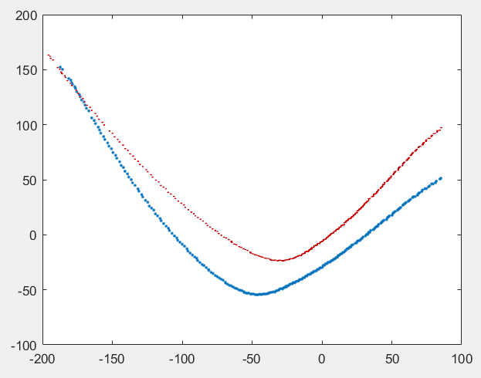
PCA model for image analysis
5. Test new images against the correct PCA shape
6. Differences in scores reflect a difference of images
Trained shape (correct) | Defected shape
AI4SD Hackathon

Slide 11
Conclusions & Future Work
Small dataset
Relevant features extracted
AI4SD Hackathon

